Slide 1


HedgeEdge Stock Trading System
A modern, secure, and efficient platform for stock trading.
Created by Cory Fishburn, Jaime Favela, and Genna Gillis

Slide 2

About Us
HedgeEdge is a modern stock trading platform built to make investing simple, accessible, and powerful for everyone. Our fully developed system offers a secure and intuitive experience for trading stocks at real-time market prices.
With fast performance, easy portfolio management, and a user-friendly interface, HedgeEdge puts control and confidence in the hands of every investor.

Slide 3

Technology Solution
HedgeEdge is a secure and scalable stock trading platform that enables users to trade in real-time, manage portfolios, and manage financial transactions, while providing administrators with full control over stock creation, pricing, and market rules, all supported by a client-server architecture, real-time simulation, and strong security measures to ensure a smooth and reliable experience.

Slide 4
Progress Update: System Completion
Technology Solution Status:
Stock trading system fully built and operational.
All major customer & administrator functions successfully developed, integrated, and tested.
Users can securely create accounts, manage portfolios, execute trades, and view real-time market changes.
Administrators have full control over stock creation, editing, market hours, and trading schedules.
Key Achievements:
Client-server architecture complete.
Real-time stock price simulation fully implemented.
Security features established for users & administrators.

Slide 5

Customer User Functions
HedgeEdge empowers customers to actively manage their investments through a range of secure, real-time features. The system supports all core trading and account management functions, ensuring a seamless user experience.

Slide 6
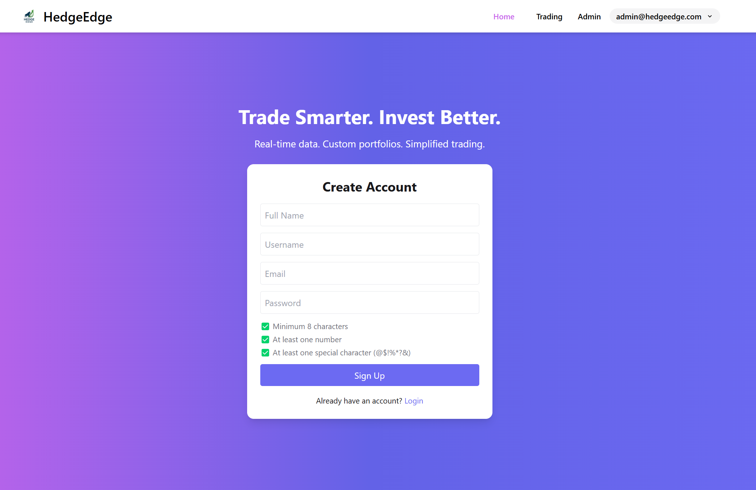

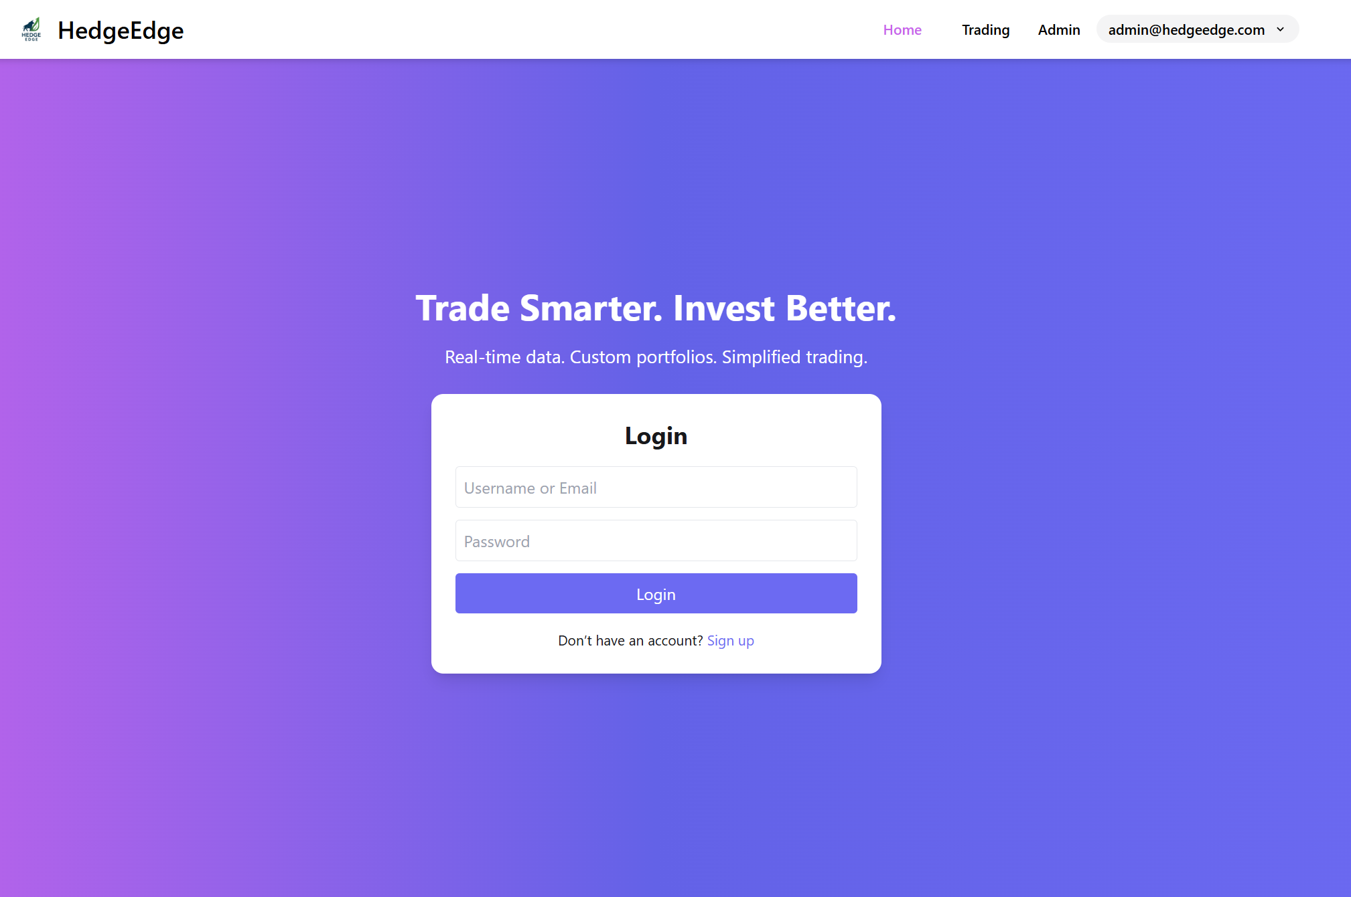
Account Management
Create account: Customers register with Full Name, Username, Email, and Password.
Login: Secure access using their username and password.

Slide 7

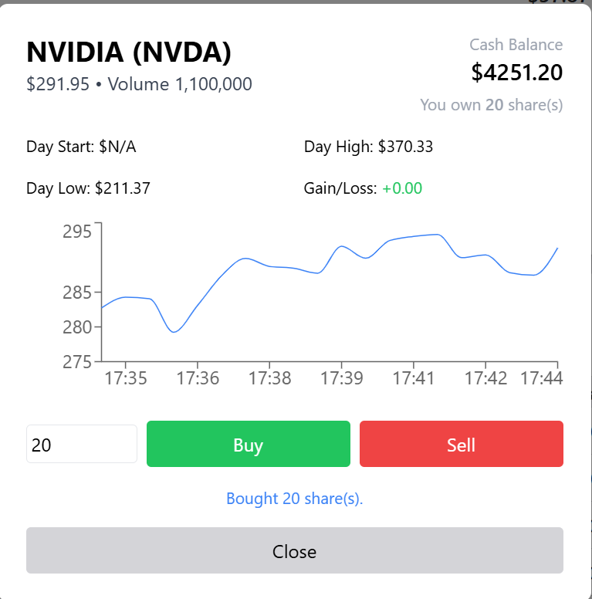
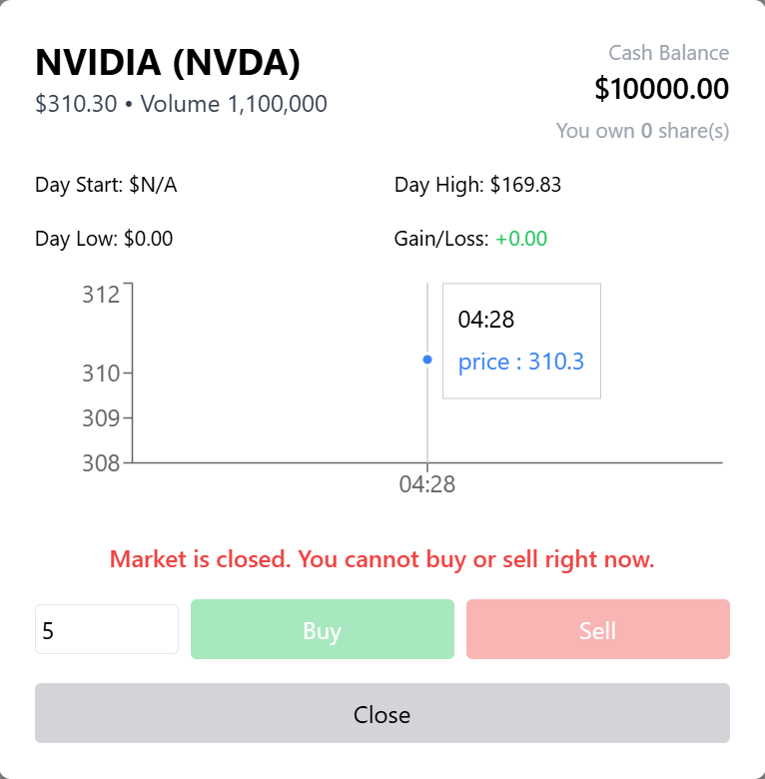
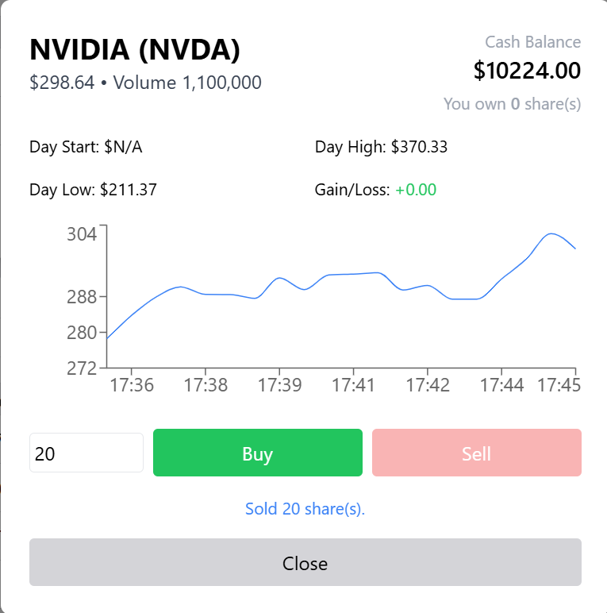
Stock Trading
Market Hours Enforcement: Trades are only allowed during designated market hours (weekdays, excluding holidays).
Buy/Sell Stocks: Users can buy or sell stocks at the current market price.

Slide 8
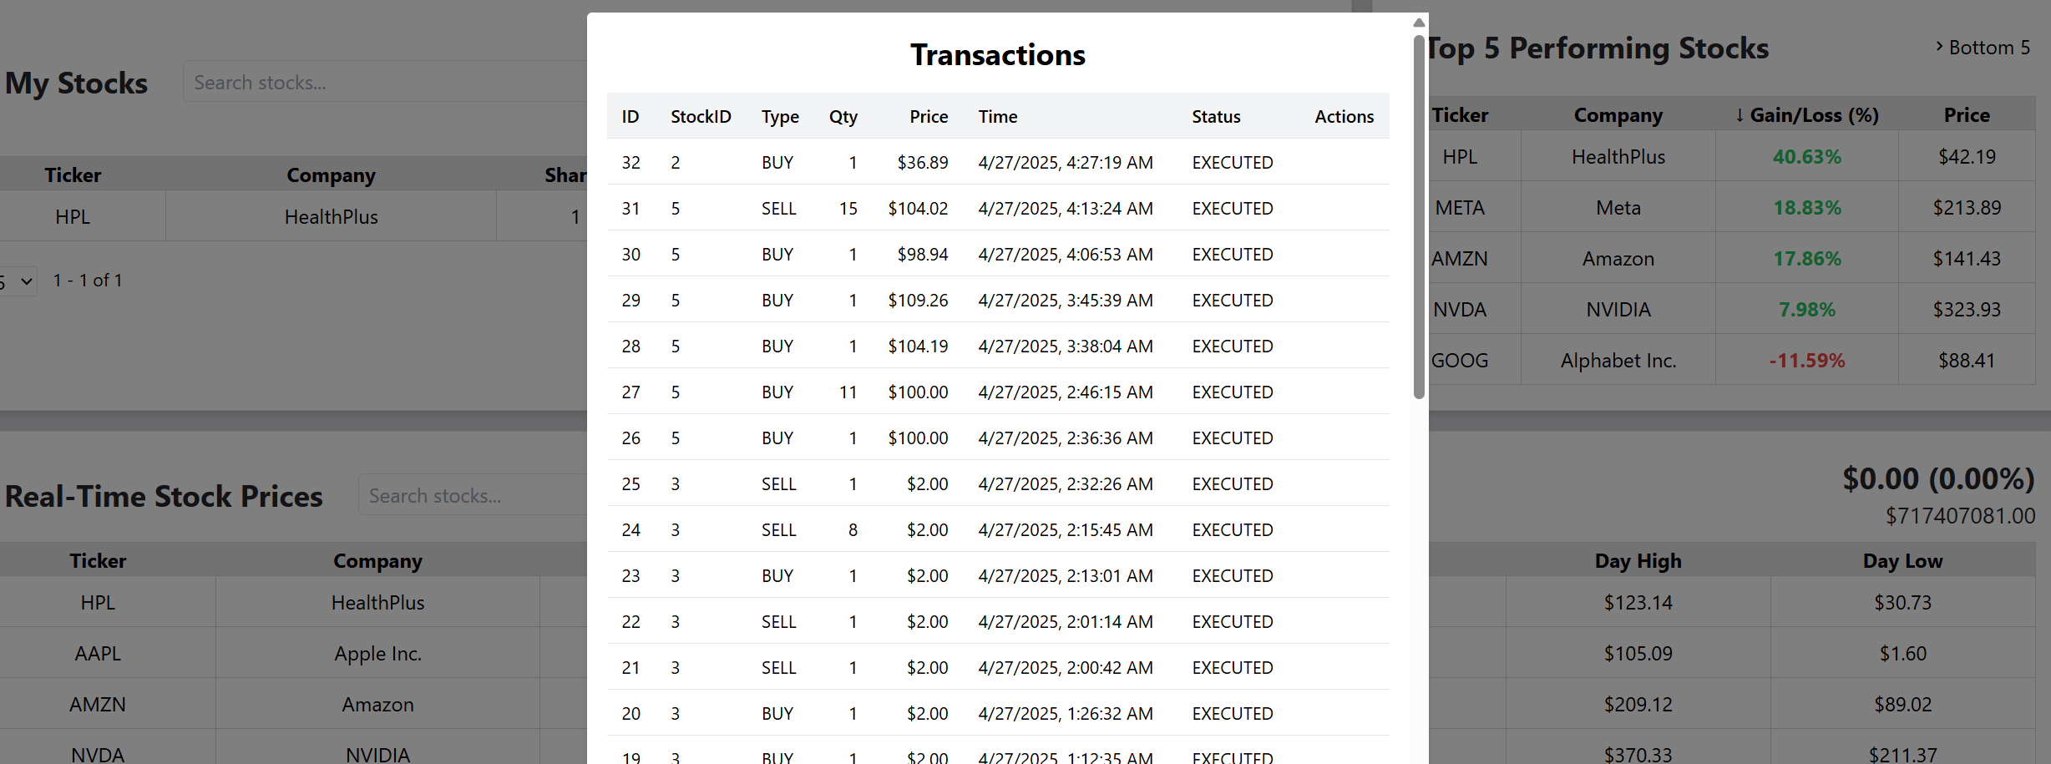
Portfolio & Transaction History
View Portfolio: Users can see real-time updates of their stock holdings and available cash.
Transaction History: Customers have access to a full log of a buy/sell orders and account actions.

Slide 9
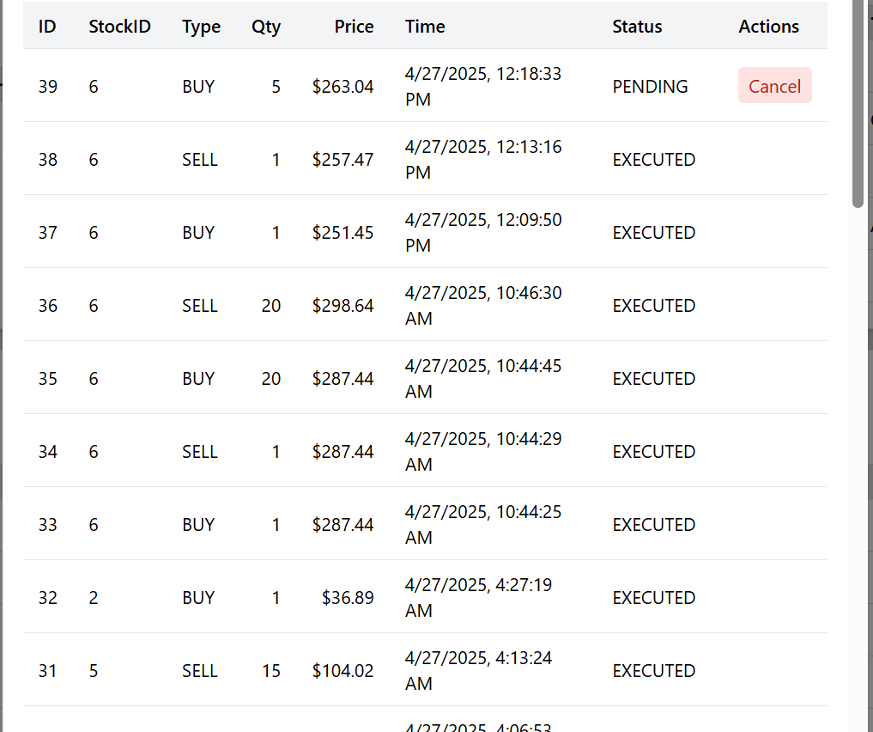
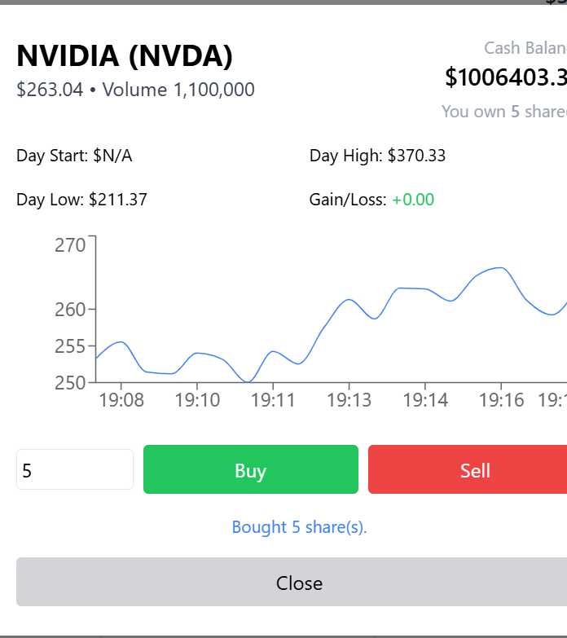
Cancel Transaction
Cancel Orders: Customers may cancel an order before it’s executed

Slide 10

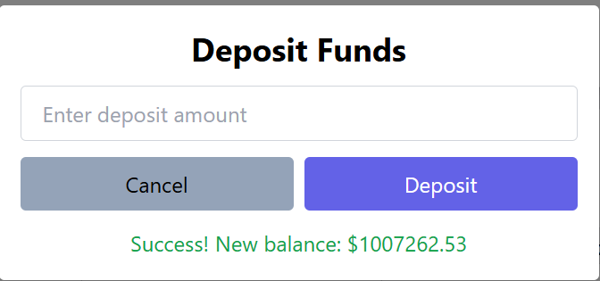
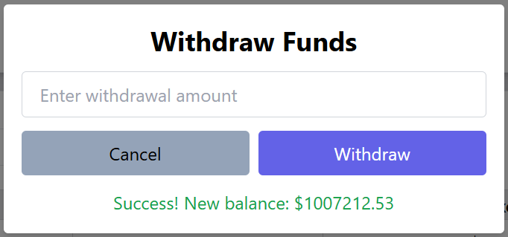
Cash Management
Deposit Funds: Customers can add money to their cash account to fund trades.
Withdraw Funds: Customers can transfer funds out of their cash account to an external source.

Slide 11

Administrator Functions
Administrators play a critical role in maintaining the HedgeEdge stock trading system by managing stocks, setting trading schedules, and overseeing market operations.
The system provides tools for secure administration and market regulation.

Slide 12
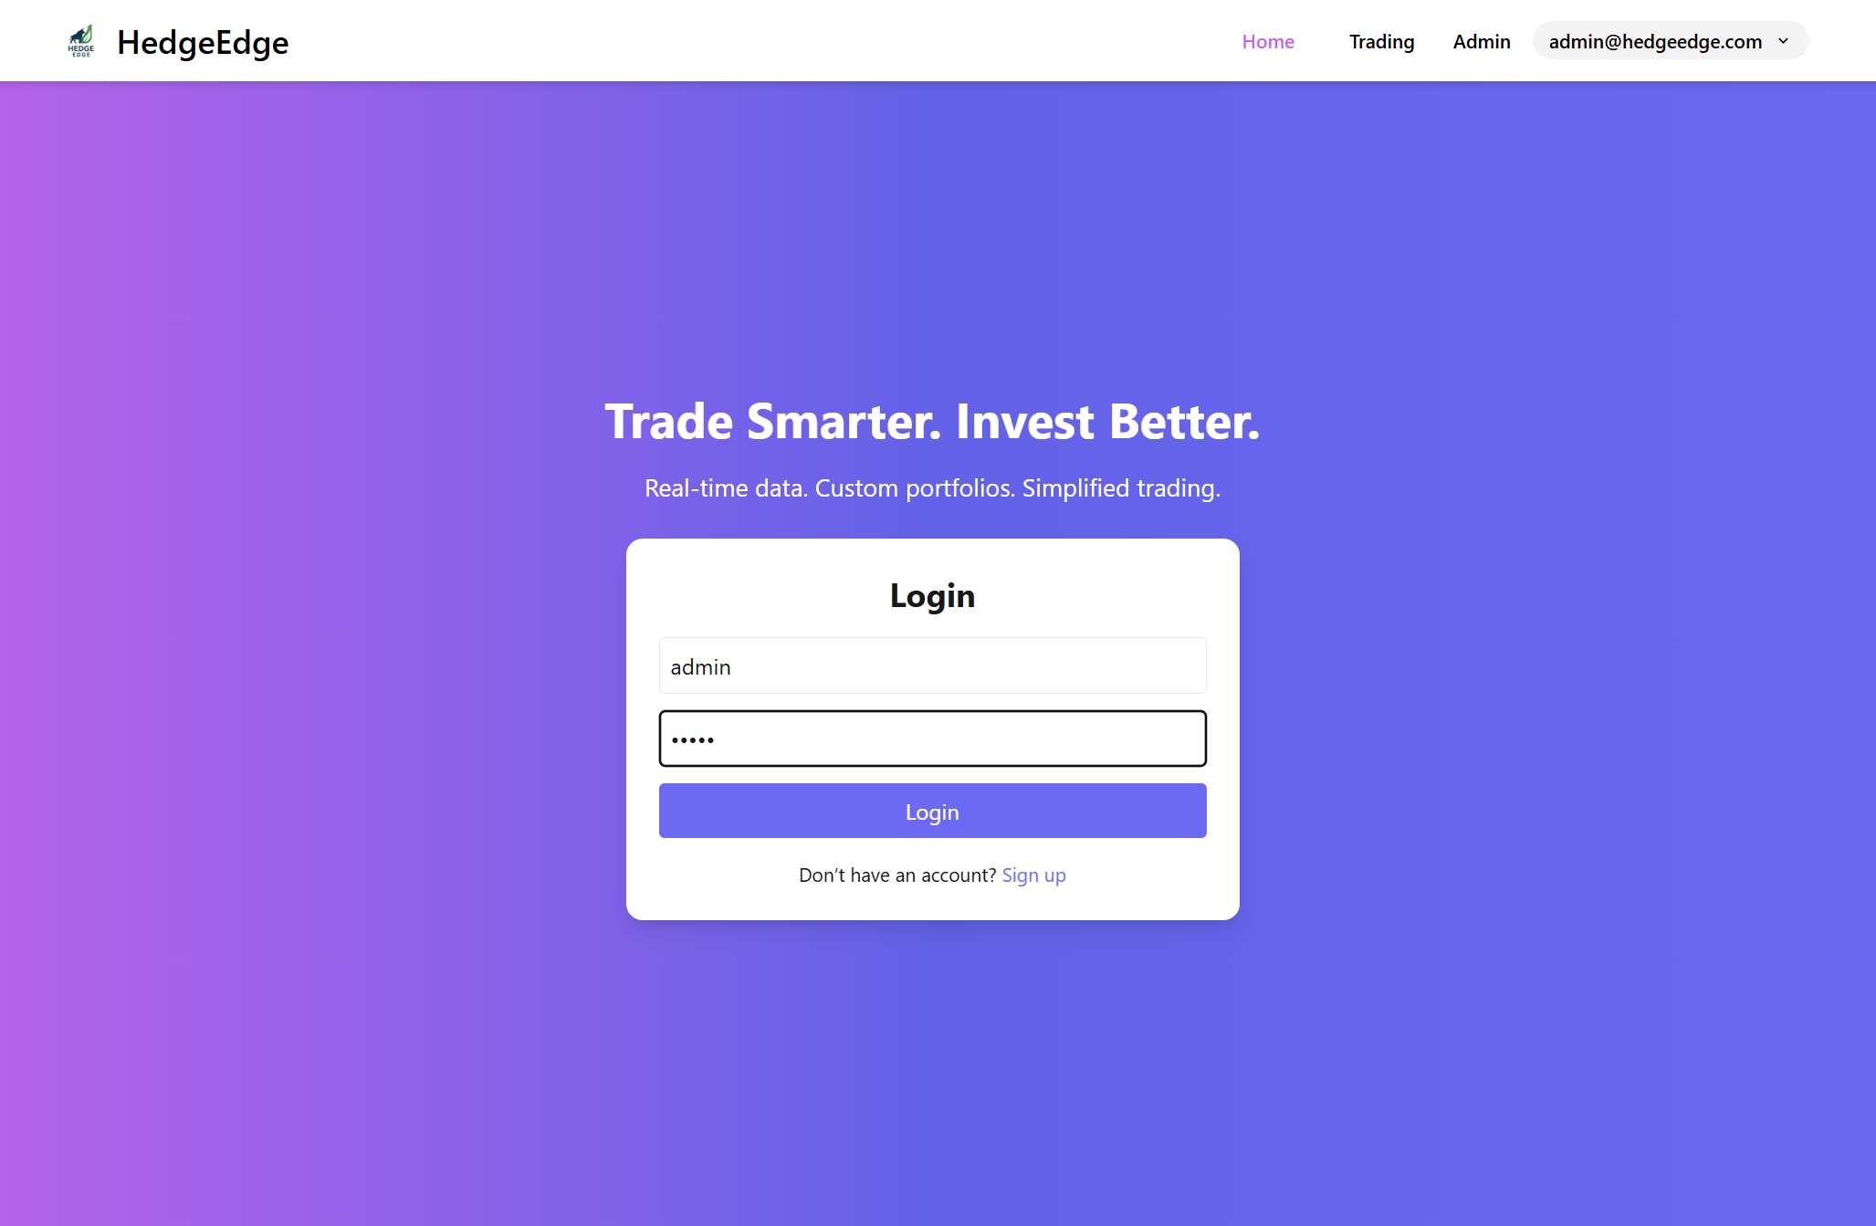
Account Access
Admin Login: Administrators can login securely with a username and password to access the administrative dashboard.

Slide 13
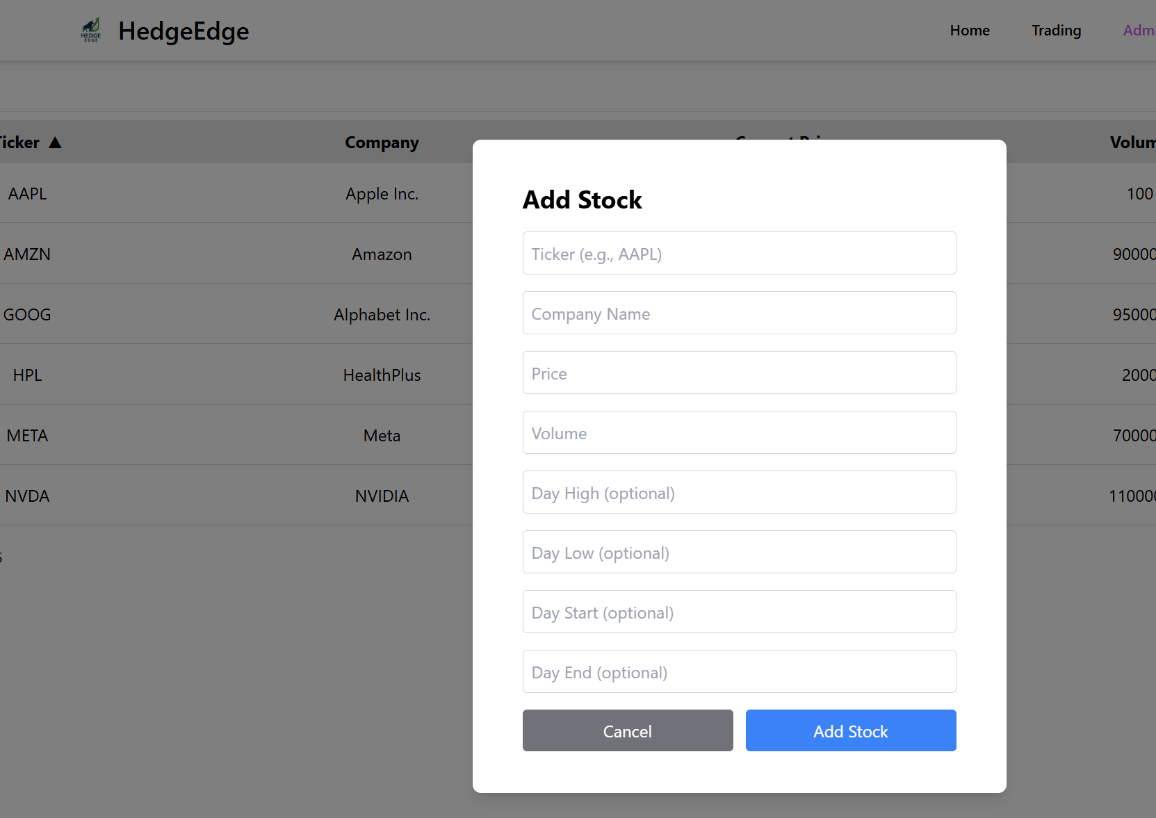

Stock Management
Create New Stocks: Administrators can create new stocks by entering the company name, stock ticker symbol, total volume (shares available), and initial price per share.
Real-Time Updates: Newly created stocks immediately become available for customer trading upon creation.

Slide 14
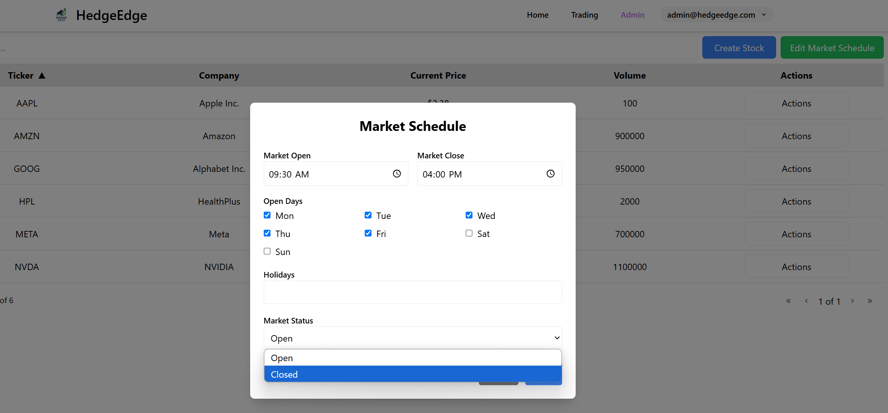
Market Management
Change Market Hours: Administrators can set the daily open and close times for the market, controlling when users can execute trades.
Adjust Market Schedule: Administrators can configure the trading calendar by specifying which days the market is open or closed (closed on holidays/weekends).

Slide 15

Database Functions
The database is the core of the HedgeEdge system, supporting all user activity, transaction management, and stock market operations.
It ensures accurate, real-time data storage and retrieval for seamless trading.

Slide 16
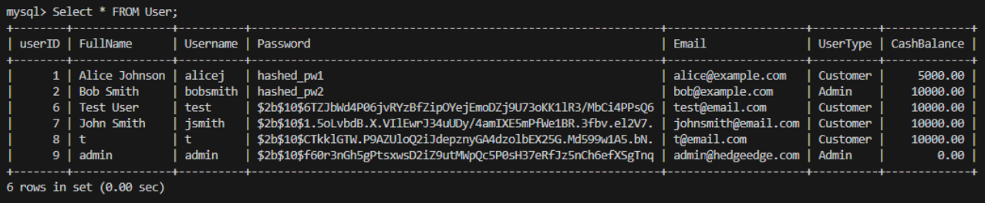
User Account Management
Stores customer and administrator information, including full name, username, email, password hash, and account type (customer/admin).
Authenticates login credentials by securely validating stored user data.

Slide 17
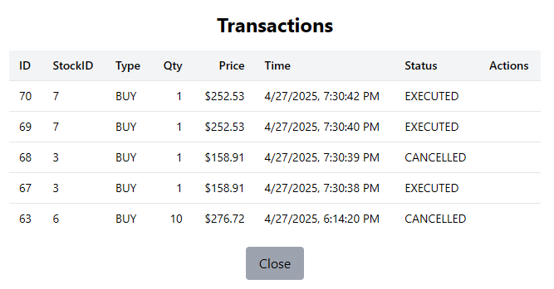
Portfolio & Transaction Tracking
Records each customer’s stock holdings, cash balance, and executed trades.
Updates portfolios automatically after every buy, sell, deposit, or withdrawal action.
Stores a complete transaction history for transparency and auditability.

Slide 18
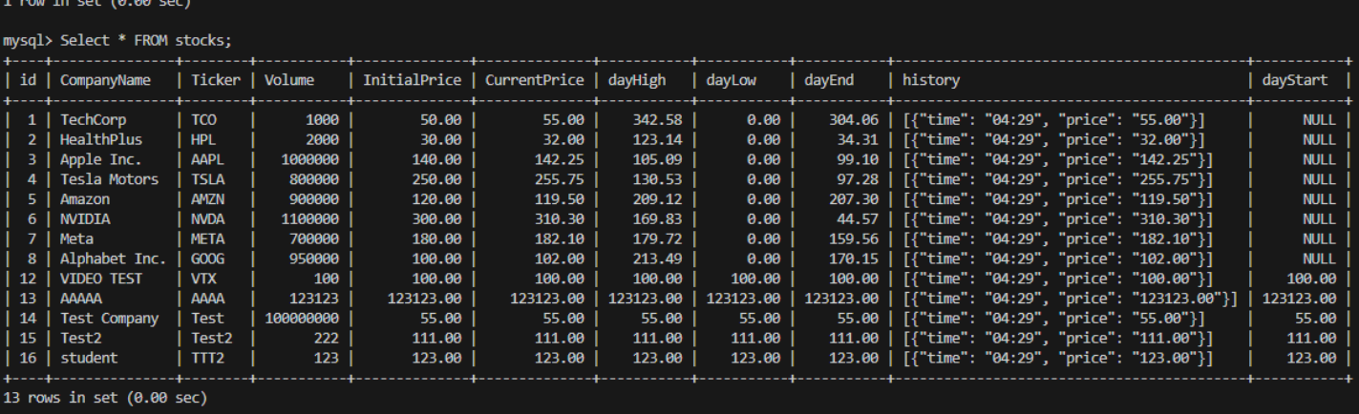
Stock Market Data Management
Stores all created stock listings, including company name, stock ticker, initial price, available volume, and real-time price updates.
Supports dynamic price changes generated by the Stock Price Generator.

Slide 19
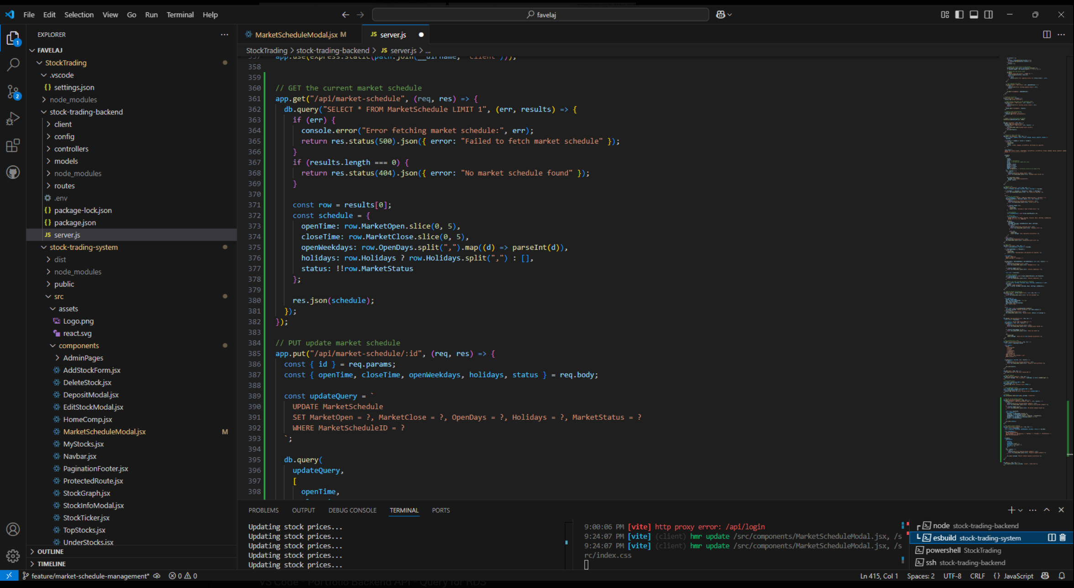
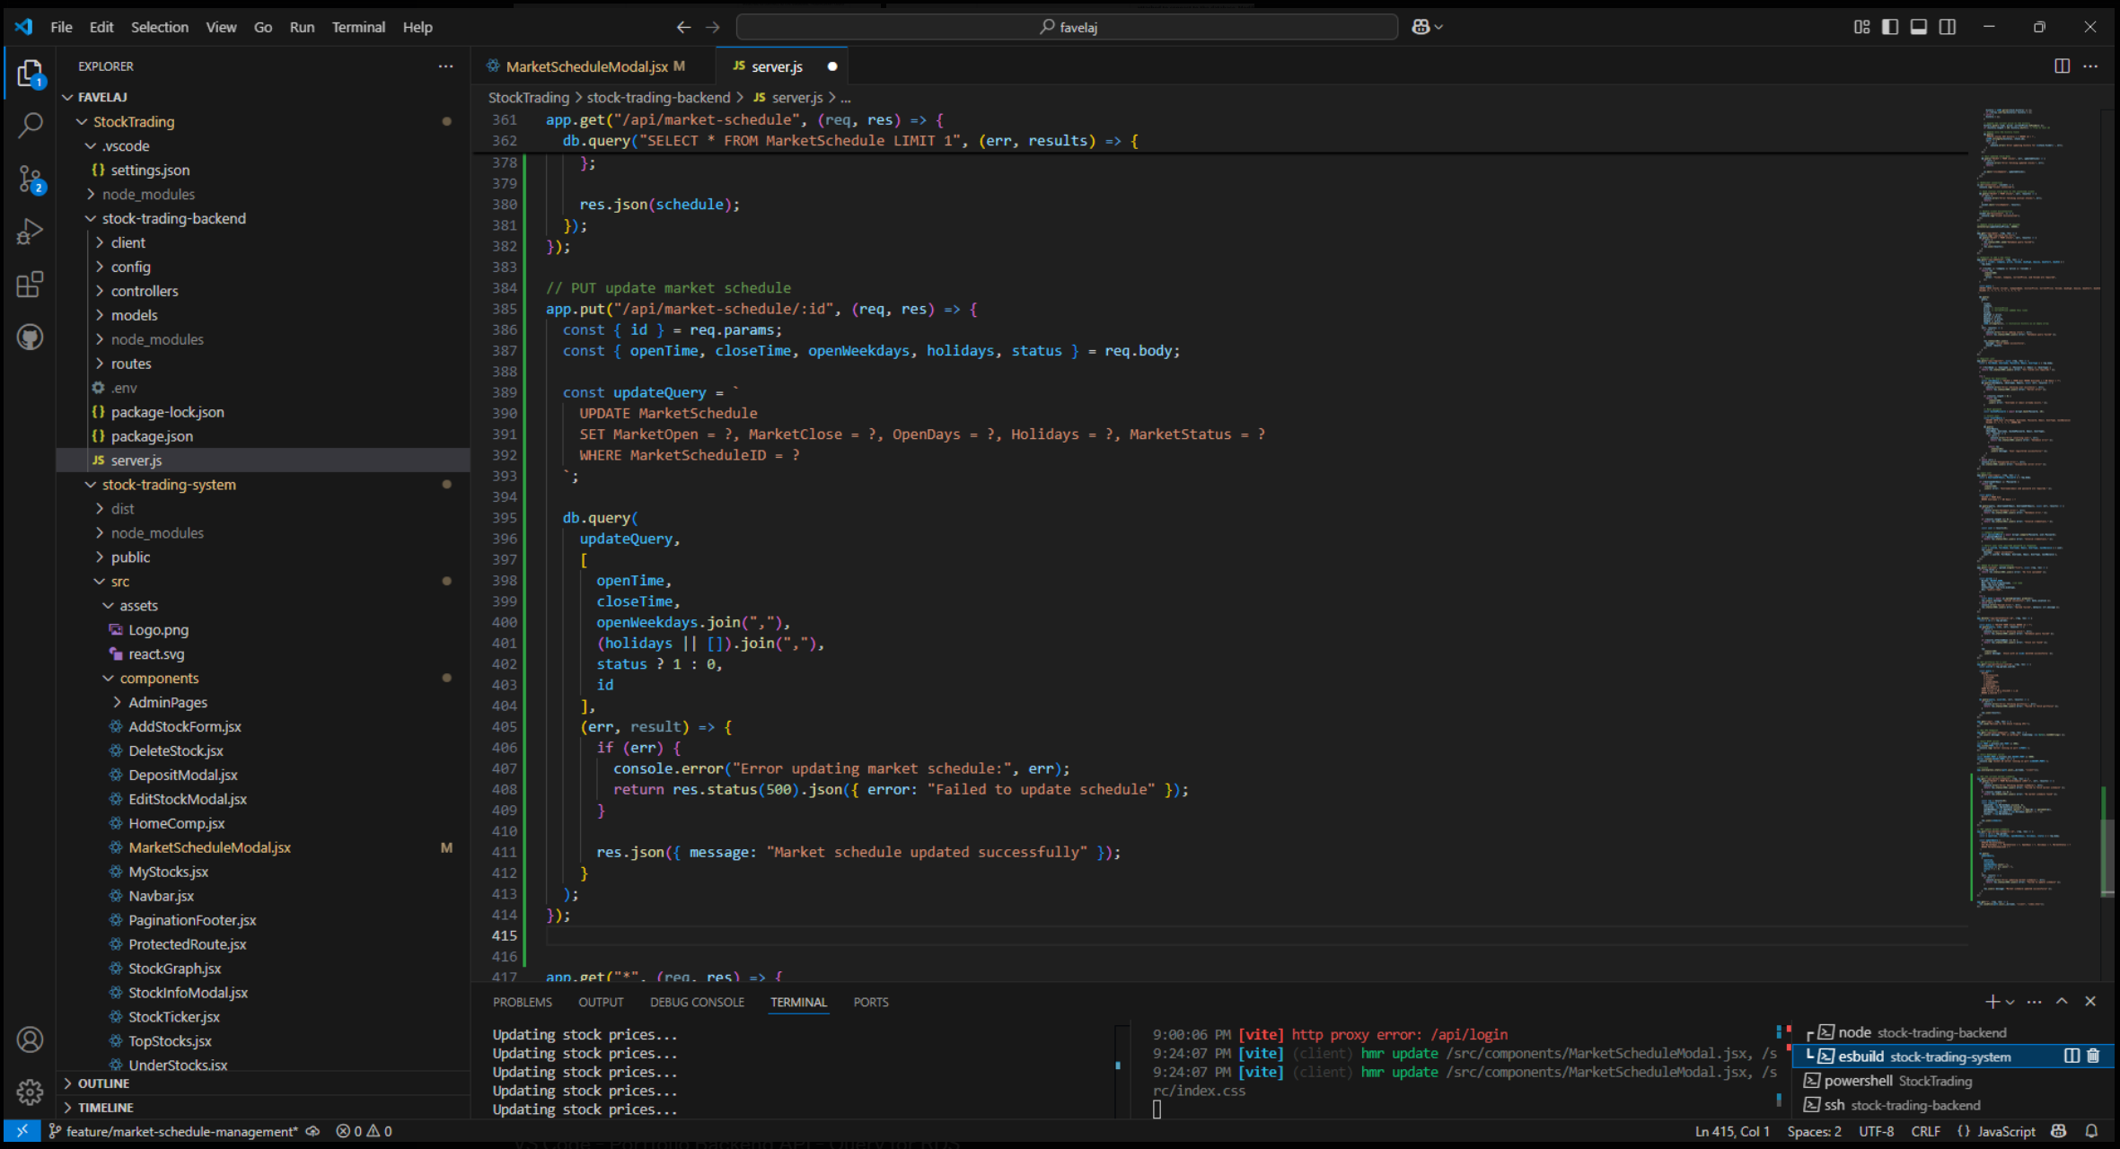
Market Schedule & Trading Rules
Maintains trading schedules, market open/close times, and holiday closures.
Validates whether a trade request is allowed based on current market hours.

Slide 20
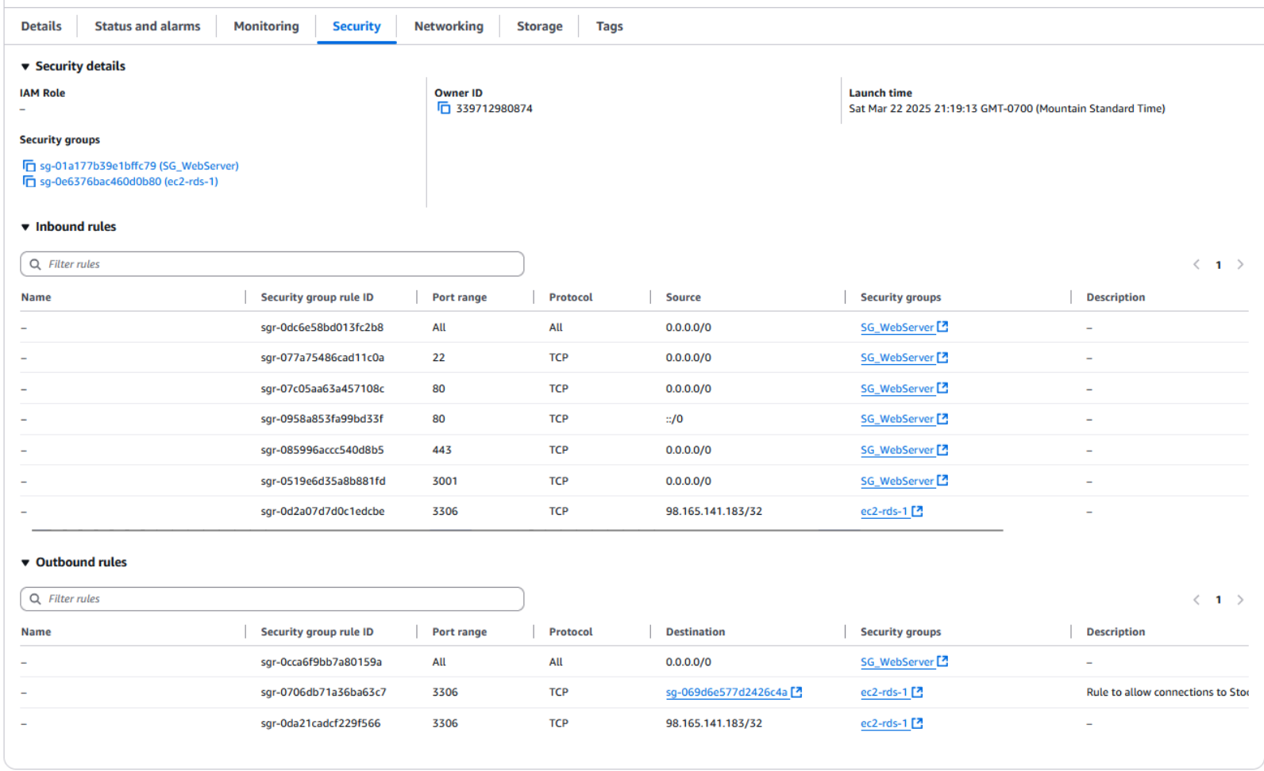
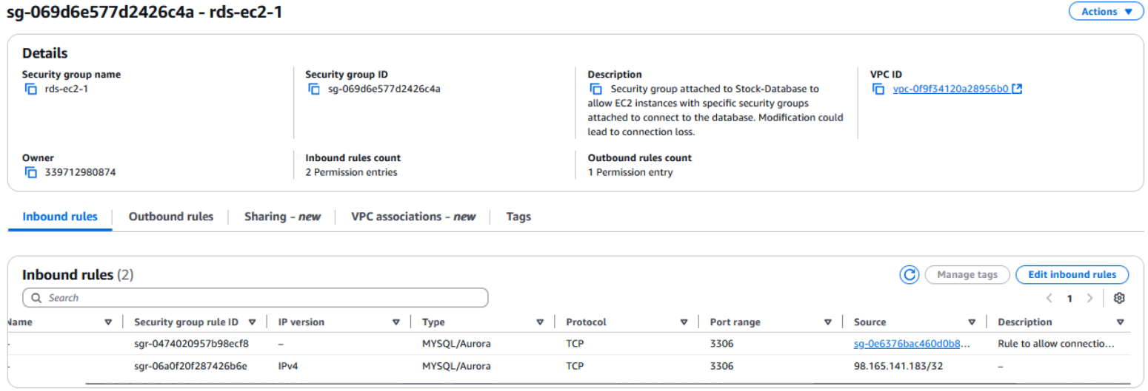
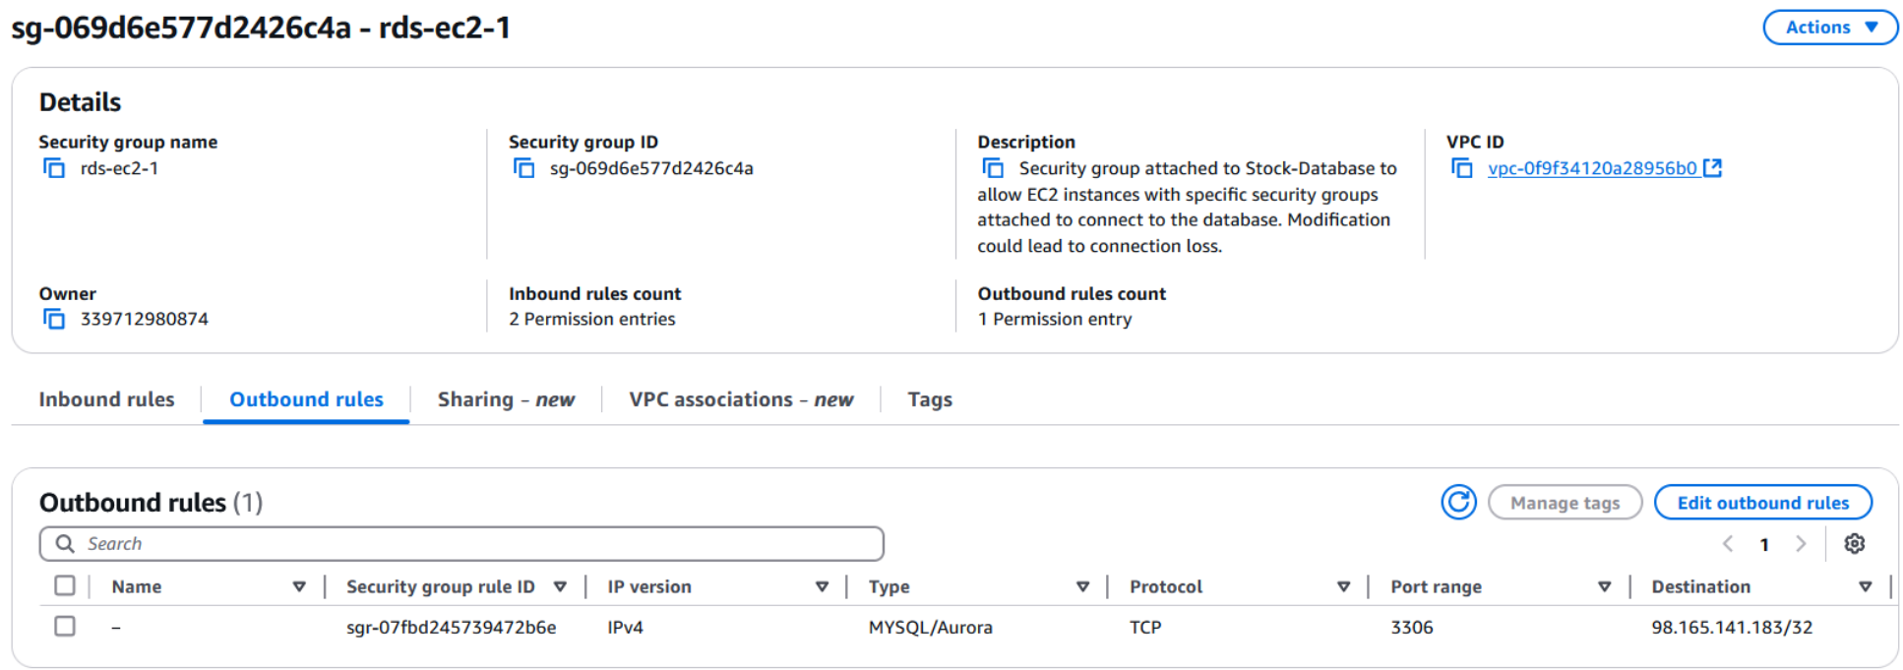
Security & Data Integrity
AWS EC2 to RDS Security Group for RDS connectivity -Inbound and outbound
AWS EC2 instance Security group inbound and outbound rules for connectivity

Slide 21

Stock Price Generator Function
The Random Stock Price Generator simulates real world market behavior by dynamically adjusting stock prices throughout the trading day, creating a more realistic and engaging experience for users.

Slide 22
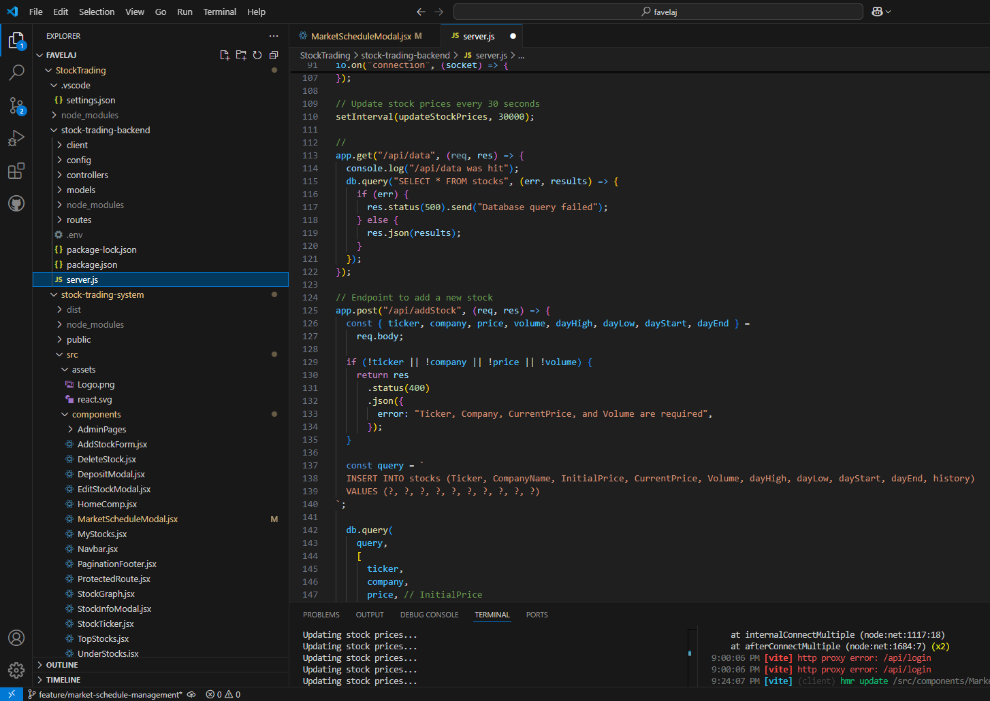
How it works
A custom algorithm randomly adjusts stock prices up or down within a controlled range.
Prices fluctuate slightly over time rather than changing drastically, mimicking real stock market movement.
Price updates occur at regular intervals while the market is open.
The generator is active only during market hours, respecting trading schedules set by administrators.

Slide 23

Purpose and Impact
Creates a dynamic trading environment that reacts like a live market.
Provides customers with opportunities for buying low and selling high based on real-time simulated price shifts.
Supports system realism without requiring external stock market data feeds.

Slide 24
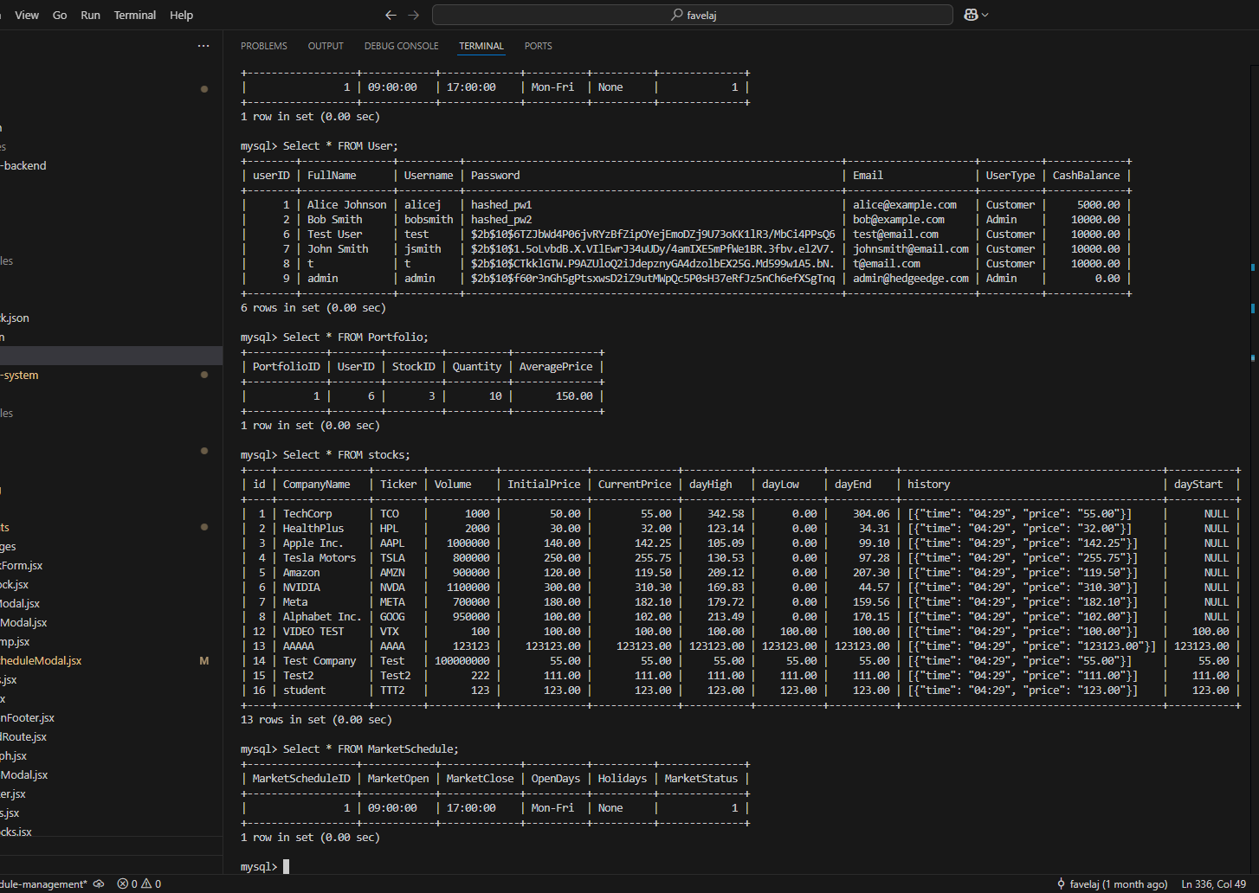
Biggest Accomplishment: Fully Integrated Database
After troubleshooting backend logic and refining our API and query handling, we resolved the connectivity and syncing issues.
We refined our API structure, updated our query handling, and implemented better logging to catch and correct errors.

Slide 25
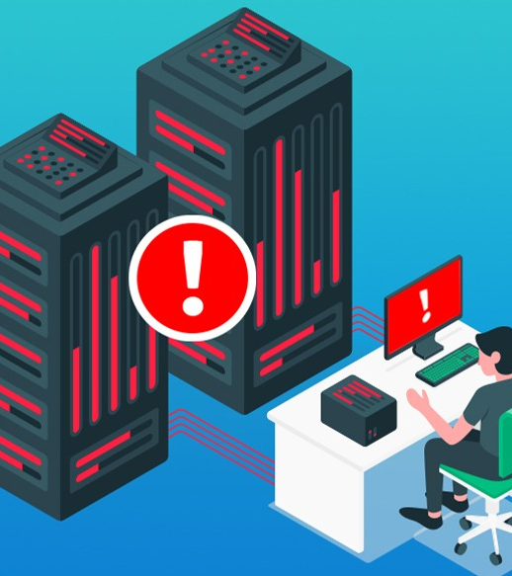
Biggest Problem: Database Integration
Early in development, we encountered persistent issues with database connectivity, inconsistent data handling, and deployment-related errors.
Data retrieval was inconsistent, portfolio updates weren’t syncing, and deployment failures disrupted access.
These problems directly impacted core features like trade execution, dashboard loading, and account updates.

Slide 26

Lessons Learned
We learned that the key to overcoming challenges lies in a team’s ability to stay grounded and adapt quickly under pressure.
When faced with a major issue before a deadline, we chose to turn in what we had, knowing it wasn’t our best work. Instead of placing blame or losing momentum, we focused on our individual strengths, supported one another, and kept moving forward with confidence.
This experience taught us how to navigate high-pressure situations as a team – an approach we’ll carry into future classes, work environments, and any project where unexpected setbacks are part of the process.
This Photo by Unknown Author is licensed under CC BY-NC-ND

